Slide 1
Providing Opportunities for Lifelong Learners
Grants Program
Informational Webinar
December 15, 2021

Slide 2
WELCOME
Michelle Nimmons
Director of Grants & Contracts
SC Afterschool Alliance
Dr. David Mathis
Deputy Superintendent
SC Dept. of Education
Eden Hendrick
Acting Director
SC Dept. of Juvenile Justice

Slide 3
Zelda Q. Waymer President & CEO SC Afterschool Alliance
Overview, Purpose, Grant Cycle, Eligibility and Key Dates

Slide 4
Overview
The SC Afterschool Alliance (SCAA) is proud to partner with Governor Henry McMaster, SC Department of Education, and the SC Department of Juvenile Justice to administer up to $14 million dollars over 3 years to support afterschool and summer learning in South Carolina.
Funding for Providing Opportunities for Lifelong Learning Grants Program has been made available through the CARES Act for the Governor’s Emergency Education Relief Fund and the American Rescue Plan Elementary and Secondary School Emergency Relief (ARP ESSER), signed into law by President Biden in March of 2021.

Slide 5
Purpose of the grant
Afterschool and summer learning programs must be well designed and well delivered.
Programs must expand opportunities and implement activities and interventions that respond to students’ academic, social, and emotional needs and address the disproportionate impact of COVID-19.
Who can you support?
Students kindergarten through 12th grade who:
Live in low-income areas
Underrepresented students from major racial/ethnic groups
Students with disabilities
English learners
Experiencing homelessness or housing instability
Children and youth in foster care

Slide 6
Grant Cycles & Funding
Year 1: January 2022 – August 30, 2022
Spring 2022 : Jan 3, 2022 – May 30, 2022 – Up to $50,000.00
Summer 2022 – June 1 – August 30, 2022 – Up to $50,000.00
Spring and Summer: Up to 100,000.00
Successful Grantees
Year 2: September 1, 2022 – August 30, 2023
Year 3: September 1, 2023 – August 30, 2024
NOTE: These dates are subjected to change.
Special Considerations
Projects may start no earlier than January 3, 2022.
Payments may be on a reimbursable basis.
Grantees will be required to submit invoices and evidence of purchases and services.

Slide 7
Who is eligible to apply?
Community– based Organizations and groups
Faith-based Organization
Sites located in communities with no current programs receiving government funds through 21st Century Community
Parks and Recreation Centers
Non-profits
Organizations may submit one application per program site.
Priority will be given to programs offering in-person programming, 4 days or more a week.

Slide 8
Key Dates
Monday Dec. 6, 2021 | Request for Proposals Released
Wednesday, Dec. 15, 2021 11:00 a.m. – 12:30 p.m. | Webinar: Overview of RFP, clarifications and questions.
Friday, Dec. 17, 2021 | Webinar recording posted on SCAA’s website at http://scafterschool.com/arp-grants/
Thursday, Dec. 30, 2021 | Application submission deadline at 11:59 p.m. Online submissions are strongly encouraged.
Jan. 3-17, 2022 | Clarification Questions and Application Review
Week of Jan. 17, 2022 | SCAA notifies all applicants of the status of their request. Official Grant Award notification will be emailed. *Funded programs will be notified first and will be posted on the SCAA’s website
Week of Jan, 17, 2022 and Week of Jan. 24, 2022 | Grant award agreements/contracts sent and signed
Feb. 22, 2022 | Grantee Orientation (Reporting requirements and data collection) *Attendance Required

Slide 9
Priority populations for this funding
Students with disabilities, including physical, developmental and/or intellectual disabilities; special health care needs
Youth eligible for free or reduced-priced lunch
English language learners
Youth experiencing homelessness or housing instability
Youth in foster care
Migrant youth
BIPOC Youth (Black, Indigenous, People of Color)
K-5th Grade (Elementary School)
6th-8th Grade (Middle School )
9th – 12th Grade (High School)

Slide 10
Michelle Nimmons Director of Grants and Contracts SC Afterschool Alliance
Review of Grant Application

Slide 11
Supported program components
Learning Acceleration (Required)
*Strategically prepares students for success in the present— this week, on this content
*Addresses past concepts and skills in context of future learning
*Jump-starts underperforming students into learning new concepts before their classmates even begin
*Creates opportunities for struggling students to learn alongside their more successful peers
*Establishes and maintains strong and intentional links to the school day
Well-being and Connectedness
* improved relationships with peers, family and school
* Social –Emotional Learning
Enrichment Activities
*Arts and crafts
*career/job exploration
* Youth entrepreneurship
*This is not an exhaustive list of activities under the supportive components*

Slide 12
Allowable expenses
Reduction in participation costs for families
Expansion of existing programs
Establishing new programs
Salaries and benefits for staff
Professional learning opportunities for staff
Approved field trips for participants
Transportation of participants
Food
Program equipment and technology
Enrichment activities

Slide 13
Unallowable expenses
Pre-award expenses
Field trips for non educational purposes
Unapproved field trips
Advertisements, promotional or marketing items
Decorative items
Purchase of facilities and vehicles
Capital improvements and permanent renovations
Dues to organizations, federations or societies for personal benefits

Slide 14
Grant application checklist
Getting Started
Decide program focus area you will apply for:
American Rescue Plan funding (K-5th) (6th – 8th )
GEER funding (6th –8th) (9th-12th)
Contact and Organizational Information
Name of primary contact, phone number, email
Organizations legal name
Annual budget
When your organization was founded
CEO name
Type of organization you are

Slide 15
Checklist cont.
Contact and Organizational Information - continued
Title of your program
Your target population: K-5, 6-8, 9-12
Population you will serve:
Students with disabilities,
Youth in foster care
English language learners
Homeless youth,
Migrant youth,
BIPOC youth (Black, Indigenous People of Color)
Youth who qualify for free or reduced-price lunch
You have prepared a brief statement that describes the population you’ve chosen to serve.

Slide 16
Checklist cont.
Identify the school district(s) attended by the youth you plan to serve
Identify the key components you will address to in your program:
Learning acceleration (required)
Enrichment activities
Healthy eating/physical activity
Well-being and connectedness
- Parent/child activities
- Mental health support
- Social-Emotional Learning
Youth at risk behaviors

Slide 17
Checklist cont.
Make sure you’ve stated how your program will help address the needs of students at risk of educational failure
Program design and implementation
Are your evidence-based program goals, objectives and outcomes measurable?
Have you described how your staff will collaborate with local schools to ensure student success?
Did you tell us how you will help students recover learning loss and accelerate learning.
Did you choose which grant cycle you’re applying for?
Checked days of week, start and stop times for programming?
Did you list your partners and their contributions?

Slide 18
Checklist cont. program design and implementation
Addressed how cost will be covered.
Decided if transportation will be offered and explained my response.
Made a decision about offering meals and explained.
Decided how many staff members are needed and if new staff will be hired.
Addressed sustainability after funding ends.

Slide 19
Checklist cont.
Budget
*Have you identified how much you’re asking for?
*Did you enter numbers in each budget category?
*Did you check question 48 confirming the budget?
*Did you write descriptions for each budget expenditure?
Assurances
*Have I checked questions 50-53

Slide 20
The grant application and resources
To begin your application process, please go to the application link on the grants page located at http://scafterschool.com/arp-grants/
A recording of this webinar session will be posted on SCAA’s website at http://scafterschool.com/arp-grants/ for your viewing convenience.
FAQ (Frequently Asked Questions), will be posted on the grant’s page.

Slide 21
Reporting and what will be requested?
Grantees will report on a quarterly/annual basis – Schedule: TBD
Preliminary list of data that will be requested:
* Number of youth served
* Demographics of youth served
* Program daily attendance
*Dosage: number of days and hours of programming offered
*Youth satisfaction and sense of belonging
*Grantee specific goals/outcomes required upon acceptance of award
*Budget for subsequent funding years i.e., Year 2 (submit in 2022)

Slide 22
Proposal review process
SCAA is pursuing expansive, statewide outreach to engage application reviewers with a focus on recruiting strong representation of individuals with experience or connections to youth development.
All reviewers will be asked to disclose conflicts of interest. Small groups of reviewers will read and independently score approximately 15 applications each.
All reviewers will use the same scoring rubric. Once reviewers have completed a through review and scoring process, SCAA will review the scoring from across all groups.

Slide 23
Reviewers scoring rubric
Section 1: Contact and Organization Information; Program Priorities - 24 points
Section 2: Program Design, Implementation, Staff, Sustainability and Partnerships - 60 points
Section 3: Budget - 16 points

Slide 24
Remember to
Use the grant webpage: http://www.scafterschool.com/arp.grants
Contact
Michelle Nimmons, Director of Grants
and Contracts
(803) 254-5454
or via email at mnimmons@scafterschool.com

Slide 25
Dr. Terry Peterson SC Afterschool Alliance Board Member Chief Counselor to Former U.S. Secretary of Education and Governor Dick Riley
Why Afterschool & Summer Learning – Evidence-Based Programming

Slide 26
RESEARCH AND THE EVIDENCE BASE
Powerful Findings!
What community-based organizations and school districts need to know and use to help students recover from COVID disruptions and accelerate their learning and engagement.

Slide 27
Research supports the growing potential of summer and afterschool opportunities
----------
AND to address COVID disruptions
REENGAGE STUDENTS THRU
INTERESTING AND MOTIVATIONAL
LEARNING
HELP ADDRESS UNFINISHED LEARNING
IN READING AND MATH, OFFER
COLLEGE CREDIT, AND DIGITAL
BADGES
CONNECT TO COMMUNITY GROUPS,
MENTORS, CAREERS AND COLLEGES
TO BROADEN STUDENTS’ BASES FOR
SUCCESS
ENGAGE YOUTH TO KEEP THEM OUT OF TROUBLE SO PARENTS CAN WORK

Slide 28
New Report
Evidence Base For Summer Enrichment and Comprehensive Afterschool
TO HELP EDUCATORS AND COMMUNITY PARTNERS DESIGN MORE ENGAGING AND EFFECTIVE PROGRAMS AND PARTNERSHIPS
TO GUIDE WISE USE OF GEER,ARP,TITLE I, CHILD CARE, READING RECOVERY AND LOCAL FUNDS
Access the report at:
https://bit.ly/EvidenceBaseAfterschoolSummer
Paper (direct):
http://bit.ly/EvidenceBasePaper

Slide 29
Summer Learning Evidence is Very Important
A committee of the National Academies of Sciences, Engineering, and Medicine recently examined and found summertime experiences to be very important for children and youth in four domains of well-being:
Academic learning
Social and emotional development
Physical and mental health
Safety
THESE FINDINGS WERE BEFORE COVID …SO THEY ARE EVEN MORE IMPORTANT NOW!! AND SIMILARLY FOR QUALITY AFTERSCHOOL!!

Slide 30
High quality afterschool programs are proven to accelerate student achievement and development
Meta-analysis by Durlak & Weissberg, Collaborative for Academic, Social and Emotional Learning;
Expanding Minds, p. 196

Slide 31
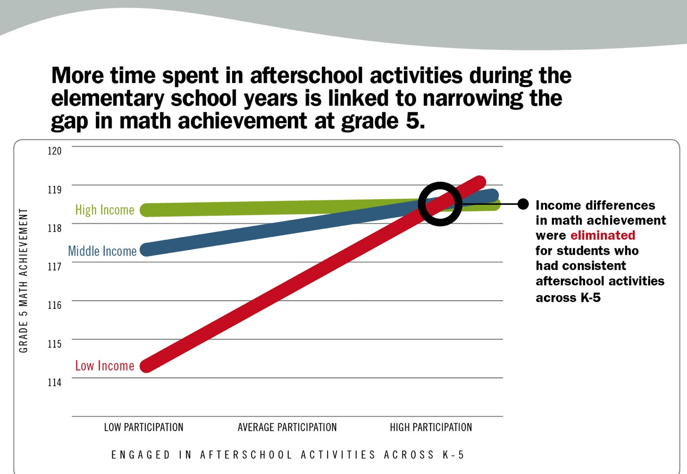
LONGITUDINAL STUDY BY DEBORAH LOWE VANDELL, PHD

Slide 32
Designing new programs and improving existing programs should FOLLOW the components from research that link to student success
Active and hands-on learning experiences and discovery
Use team building skills and learn how to resolve differences
Encourage youth ownership, making learning relevant
Support mastery: use practice to get good at something
Encourage learning new skills; exploring career and college options
This is how to make your programs evidence based!
From: Dr. Deborah Lowe Vandell and Dean Pedro Noguera in Learning in Afterschool & Summer Project. Temescal Associates

Slide 33
Leverage summers and afterschool to connect more middle and high school students to career, workforce and college options
Grow
Grow summer youth learn and earn programs and internships
Increase
Increase youth apprenticeships and entrepreneurships
Expand
Expand dual enrollment, early college courses and career and technical programs beyond the school day
Sponsor
Sponsor college and workplace visits for students with free transportation
Increase
Increase service-learning options
Expand
Expand extracurricular programs to reach more students
Offer
Offer digital badges for developing essential skills

Slide 34
Questions and Answers
Please remember to use the grant webpage:
http://www.scafterschool.com/arp.grants

Slide 35
Thank You
for
joining us today !

